Slide 1
CIS CONTROL 13: DATA PROTECTION-I
DATA PROTECTION

Slide 2
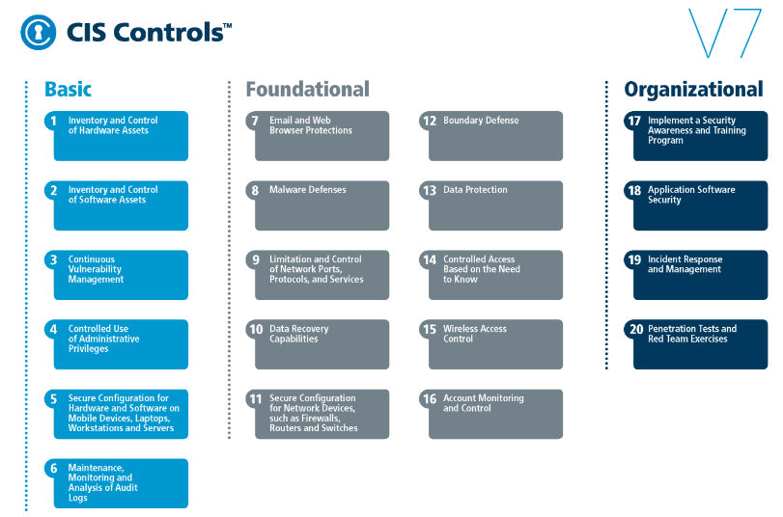
CIS CONTROL 13: DATA PROTECTION-I
https://www.cisecurity.org/controls/

Slide 3
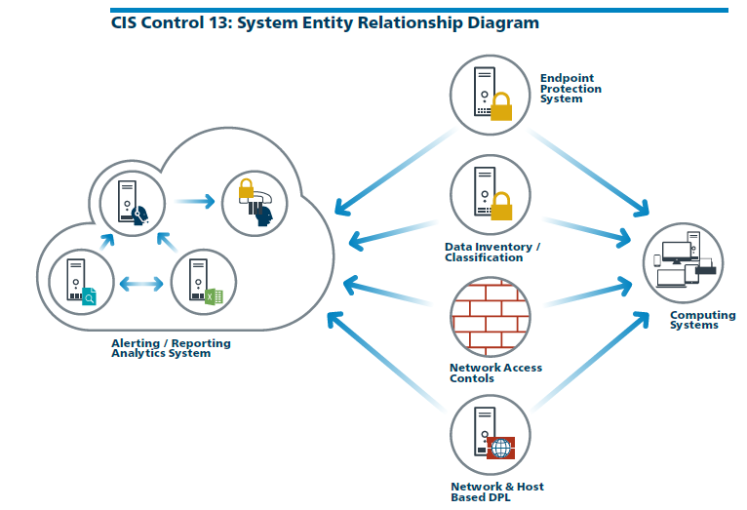
CIS CONTROL 13: DATA PROTECTION-I
https://www.cisecurity.org/controls/

Slide 4
CIS CONTROL 13: DATA PROTECTION-I
13.1: Maintain an Inventory of Sensitive Information
Maintain an inventory of all sensitive information stored, processed, or transmitted by the organization's technology systems, including those located onsite or at a remote service provider.

Slide 5
CIS CONTROL 13: DATA PROTECTION-I
13.2: Remove Sensitive Data or Systems Not Regularly Accessed by Organization
Remove sensitive data or systems not regularly accessed by the organization from the network. These systems shall only be used as stand alone systems…

Slide 6
CIS CONTROL 13: DATA PROTECTION-I
13.2: Remove Sensitive Data or Systems Not Regularly Accessed by Organization
…(disconnected from the network) by the business unit needing to occasionally use the system or completely virtualized and powered off until needed.

Slide 7
CIS CONTROL 13: DATA PROTECTION-I
13.3: Monitor and Block Unauthorized Network Traffic
Deploy an automated tool on network perimeters that monitors for unauthorized transfer of sensitive information and blocks such transfers while alerting…

Slide 8
CIS CONTROL 13: DATA PROTECTION-I
13.3: Monitor and Block Unauthorized Network Traffic
…information security professionals.
END

